Slide 1
SOCIAL MEDIA ANALYTICS
Sponsored by Atoconn Systems Private Ltd, Pune

Slide 2
D. Y. PATIL COLLEGE OF ENGG. AND TECHNOLOGY, KOLHAPUR (Dept. of Computer Science & Technology)
Presented by :
Pathan Ameer Z. 16
Kumbhar Pankaj J. 17
Bhosale Trupti V. 18
Bhosale Rimmon S. 19
Shiradwade Roshani A. 20
Under the guidance of
Prof. K.T. Mane

Slide 3
INTRODUCTION
SOCIAL MEDIA SITES
Easy-to-access tools
Allows digital communication, collaboration
An impact on the corporate world.
SOCIAL MEDIA ANALYTICS
Extracting hidden insights from unstructured social data.
Enable informed and insightful decision making.

Slide 4
LITERATURE SURVEY
Social network analysis has gained prominence due to its use in different applications-from product marketing to search engines and organizational dynamics.
1. Bogdan Batrinca, Philip Treleaven[1] Social media analytics: a survey of techniques, tools and platforms.

Slide 5
2. Youngchul Cha, Junghoo Cho [2] Social-Network Analysis Using Topic Models.
3. Eleonora D’Andrea, Pietro Ducange, Beatrice Lazzerini [5] Real-Time Detection of Traffic From Twitter Stream Analysis.

Slide 6
NEED OF WORK
Social media has broadened its scope
Social media site provide APIs analyzing but provide only a limited access to the data
Modified APIs for accessing the Facebook, Twitter data.
Interests categorized for benefits for quality and improving selling strategies.

Slide 7
PROBLEM STATEMENT
To design, develop and analyze social media website to evaluate user’s interest and to categorize them accordingly.

Slide 8
PROPOSED SYSTEM Architecture Diagram
Design and Development of Social Media Website
APIs for Extracting data
Storage of raw data
Data Processing Using LDA
Extracting Interest of Users
Storage of reports
Database
Database
Live data from Social Media SitesFacebook, Twitter
Categorization of Users

Slide 9
MODULES
Design and development of social media website.
Fetching and extracting data from social sites using API’s
Storage of Raw data and Report:
Data Processing

Slide 10
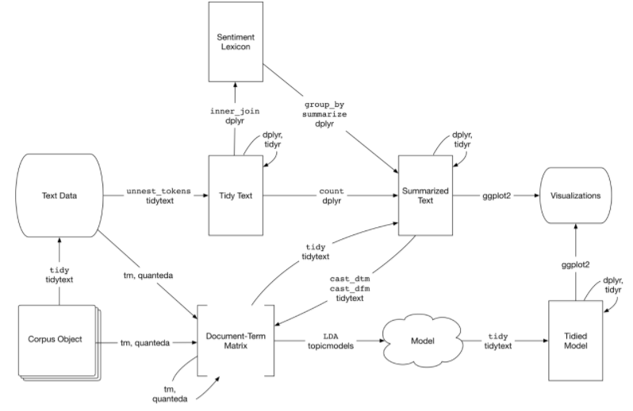
DESIGN OF ALGORITHM Algorithm based on topic modeling

Slide 11
Data Flow Diagram
Facebook
Collect Data
Raw data
Filter
Data
Analyse Data
Categorize user
Result
Twitter
Own Social Media

Slide 12
IMPLEMENTATION
Information gathering
Software Development Model : Agile
Software Requirement Specifications

Slide 13
HARDWARE SPECIFICATION
Processor : Intel Pentium IV/Advanced Micro processor Devices (AMD)
RAM : 2 GB

Slide 14
SOFTWARE SPECIFICATION
Front-end : HTML/PHP, CSS, Bootstrap, JavaScript .
Back-end : JSP, Servlets.
Database : MySQL / MongoDB
Algorithms : Latent Dirichlet allocation (LDA), Diffusion Techniques.
Software
Development : Agile
Model

Slide 15
CLASSES and FUNCTIONS USED
1) library(TwitteR2Mongo)
It identifies trending topics in the user's home timeline. Keywords are updated dynamically when new tweets appear on the user's home timeline.
2) library(topicmodels)
The R package topic models provides basic infrastructure for fitting topic models based on data structures from the text mining package tm.
3) library(tm)
It present methods for data import, corpus handling, preprocessing, metadata management, and creation of term-document matrices.

Slide 16
4) library(RMySQL)
A 'DBI' interface to 'MySQL' / 'MariaDB'. The 'RMySQL' package contains an old implementation based on legacy code from S-PLUS which being phased out. A modern 'MySQL' client based on 'Rcpp' is available from the 'RMariaDB' package.
5) library(mongolite)
High-performance 'MongoDB' client based on 'libmongoc' and 'jsonlite'. Includes support for aggregation, indexing, map-reduce, streaming, encryption, enterprise authentication
6) library(wordcloud2)
A fast visualization tool for creating wordcloud by using wordcloud2.js.A fast visualization tool for creating wordcloud by using wordcloud2.js..

Slide 17
4) library(tidytext)
Text mining for word processing and sentiment analysis using 'dplyr', 'ggplot2', and other tidy tools.
5) library(ggplot2)
A system for 'declaratively' creating graphics, based on "The Grammar of Graphics". You provide the data, tell 'ggplot2' how to map variables to aesthetics, what graphical primitives to use, and it takes care of the details.
6) library(dplyr)
A fast, consistent tool for working with data frame like objects, both in memory and out of memory.

Slide 18
Functions

Slide 19
4) library(webshot)
It identifies trending topics in the user's home timeline. Keywords are updated dynamically when new tweets appear on the user's home timeline.
5) library(htmlwidgets)
The R package topic models provides basic infrastructure for fitting topic models based on data structures from the text mining package tm.
6) library(igraph)
It present methods for data import, corpus handling, preprocessing, metadata management, and creation of term-document matrices.

Slide 20
RESULTS
Snapshots are actual output screen on running hardware. In our project snapshot is captured from web application.
The following are snapshots of the predictive system.

Slide 21
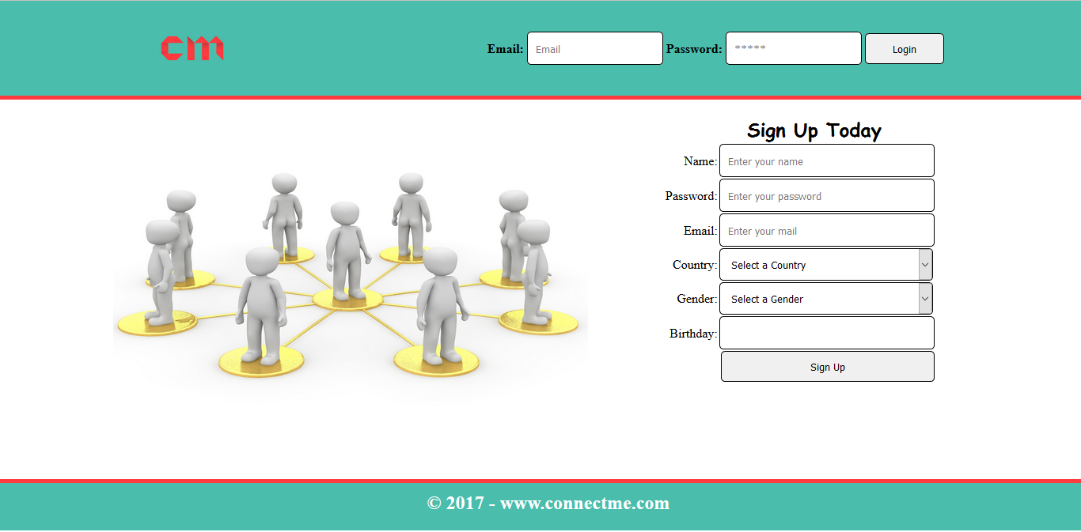
Homepage for social media site

Slide 22
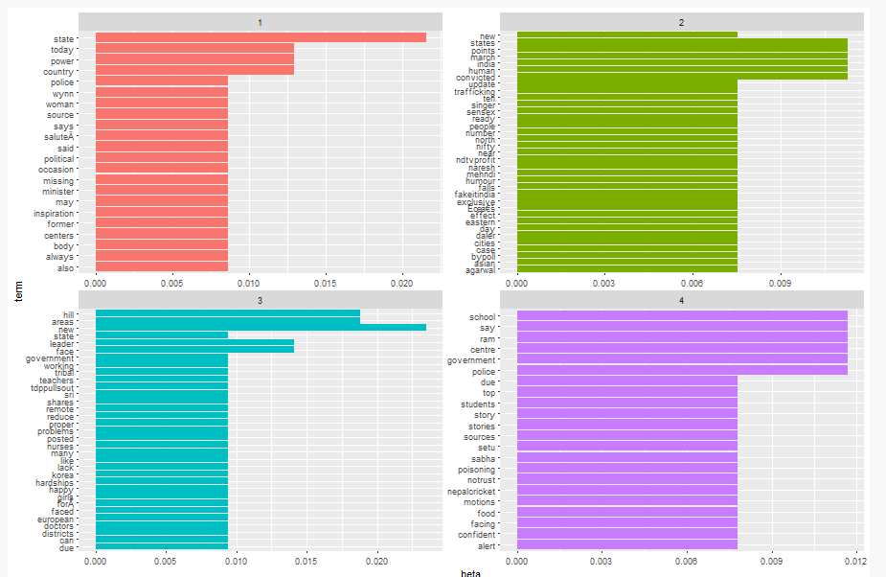
RESULT ANALYSIS Topic models

Slide 23
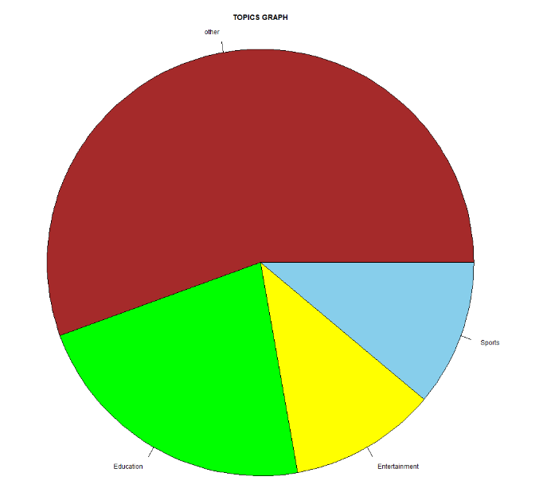
Post topics modeling graph

Slide 24
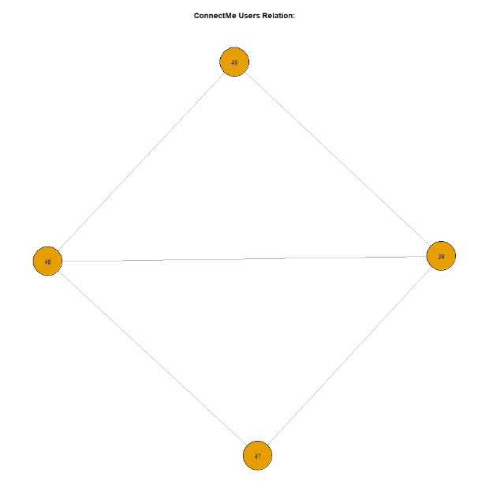
Network graph

Slide 25
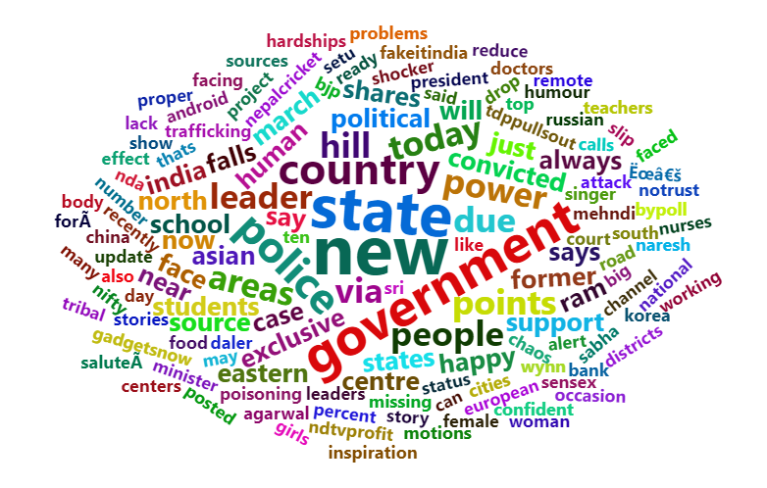
Word cloud

Slide 26
CONCLUSION
To improve the tactical execution of social media strategies.
The trends have been extracted with the help of our system.
Facebook ,Twitter data has been extracted and analyzed for topic modeling.
Trending topics are generated from the corpus gathered using LDA
It also provides analysis of user profiles

Slide 27
FUTURE WORK
To determine the topic title.
To gain faster response time for analysis.
To make the analytics part compatible with online hosting sites

Slide 28
REFERENCES
1. B. Batrinca , P. C. Treleaven. (2014).” Social media analytics: A survey of techniques, tools and platforms,” AI & SOCIETY. 30. 89-116. 10.1007/s00146-014-0549-4.
2. Youngchul Cha, Junghoo Cho,” Social-Network Analysis Using Topic Models,” in
SIGIR’12, 2012 .
3. Ashish Bindra, ”SocialLDA:Scalable Topic Modeling in Social Networks”, M.S
4. Alex Fox.(2013,April 26).Why Tracking your social media is important. [online].Available:http://www.seguetech.com/why-tracking-your-social-media-analytics-is-important
5. Steve Hamby.(2012,May 15).Five Reasons to Use Social Media Analysis. [online].Available:http://www.huffingtonpost.com/steve-hamby/social-media-analysis_b_1344666.html

Slide 29
6. K. Larson, R. and Watson, "The Value of Social Media: Towards Measuring Social Media Strategies," in Proc. of the 32 International Conference on Information Systems (2011), China.
7 J.B. Barney, "Firm Resources and Sustained Competitive Advantage," Journal of Management 17:1 (1991), 99-120.
8 . D.J. Teece, G. Pisano, and A. Shuen, "Dynamic Capabilities and Strategic Management," Strategic Management Journal 18:7 (1997), 509-533.
9 . P.M. Di Gangi, and M. Wasko, "Steal My Idea! Organizational Adoption of User Innovations From a User Innovation Community: A Case Study of Dell IdeaStorm," Decision Support Systems 48:1 (2009), 303-312.
10. Kurniawati, G. Shanks and N. Bekmamedova, "The Business Impact of Social Media Analytics," Proc. European Conference on Information Systems 2013, Paper 52.

Slide 30
THANK YOU

